Slide 1
Spark Math
What is our advantages?

Slide 2
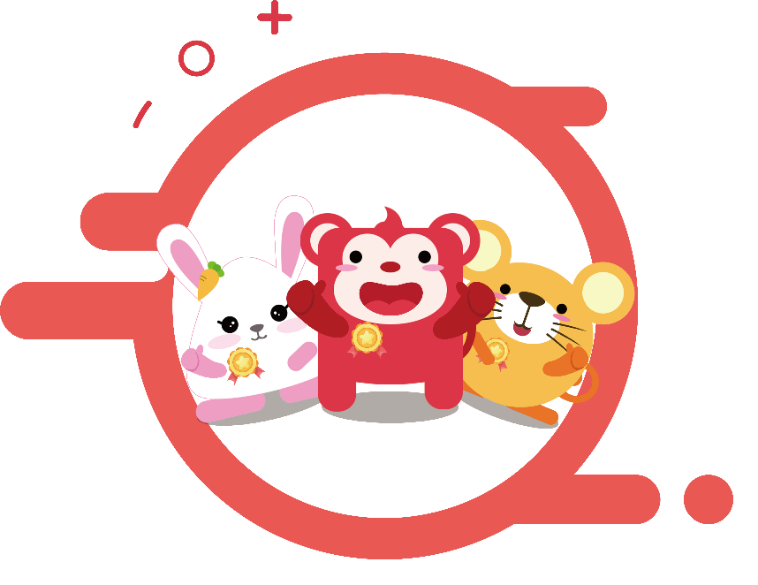
Product Advantages
Two interfaces – Live Teacher and AI Interaction
with gamified questions and animations
Top quality teachers with ongoing training to ensure success
Singapore Math Pedagogy aligned with US Common Core Standards
Student-Centered Teaching
Small class setting with live instruction
Open communication with parents: Monthly progress reports
Comprehensive Sequence of Study

Slide 3
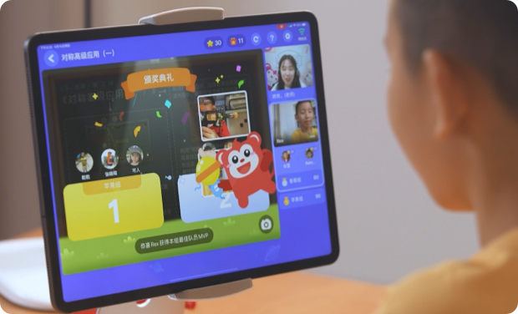
Small class setting with live instruction
Small class with live teaching
Our curriculum adopts the model of “same teachers, same classmates and same class time”, aiming to maintain the continuity of learning and let children develop good study habits.
Children can develop the social skills in small-group setting
1:1 attention and interaction with teacher
Speak in the group and build confidence
Explore and adapt to primary school course rigor in advance
Take the class wherever you are in a convenient and efficient way
Parent supervision, visible results
Our courses are taught in small classes online, and are delivered in English. Generally, there are no more than 6 students per class, so that children can learn and discuss in a group. Every child can interact with the teacher frequently, and get teacher’s full attention and customized comments. There are also many opportunities for communication and discussion among children themselves. We also arrange opportunities for students to present their thinking with one another, allowing them to show how they work out a problem and create purpose and engagement. This atmosphere not only helps children learn from each other, but also encourages cooperation and healthy competition. As a result, children are fully engaged in class, which sparks their enthusiasm and passion for learning. Moreover, our courses help children to adapt to primary school in advance, so that they can be better prepared for future learning.
Notes:
小班直播可以营造社交式 、讨论式的学习氛围每个孩子都有与老师高频互动的机会，能够获得老师的充分关注与点评。
孩子与孩子之间也可以有很多交流和讨论的机会。课堂上，孩子会有很多上台表达的机会，在其他小朋友面前展示自己的解题思路，这可以很好地提升孩子的语言表达能力与课堂参与感。在这种学习氛围下，学生间不仅能互相学习，还能分组合作，并互相竞争，让孩子获得满满的参与感，这会大大增加学习的积极性，让孩子爱上学习。
并且，这种模式可以让孩子提前适应小学的学习生活，孩子读小学后适应性也会更强。

Slide 4

Curriculum design
NEL (Nurturing Early Learners), the curriculum framework for kindergartens in Singapore
A
B
Singapore MOE curriculum syllabus
C
Common Core States Standards (CCSS) of the US
D
Singapore public school textbooks and Singapore Math Kangaroo Contest (SMKC)
Our Spark Math program is based on a Singapore math curriculum and is aligned with United States Common Core Standards. Singapore math teaching methods feature visual and concrete representations that develop into more abstract thinking skills. This methodology builds a strong mathematics foundation so that children develop confidence and analytical thinking skills.
Notes:
NEL：Nurturing Early Learners，《培育幼儿：新加坡学前课程》。NEL课程是由新加坡教育部开发的一套资源，它是用来支持幼儿教育工作者为4至6岁的儿童创造优质的学习体验的。
MOE：Ministry of Education ，新加坡教育部。
SMKC：Singapore Math Kangaroo Contest，新加坡袋鼠数学大赛。这项考试开放给小一到小六，中一到中四，初级学院，以及理工学院的学生参加。 进了小学，同学们就可以尝试了。
CCSS：Common Core States Standard， 共同核心州立标准。是“英语语言艺术和数学能力”的教学标准。是给美国的中小学阶段（K-12，也就是kindergarten到12年级）制定的课程标准，目的是为大学招生和社会教育提供评判标准。
the 21st Century Competencies，21世纪核心素养。它是由北京师范大学中国教育创新研究院与美国21世纪学习联盟（Partnership for 21st Century Learning）开展合作完成，是中美学术团队深度合作完成的一份围绕21世纪核心素养教育的解决方案。

Slide 5
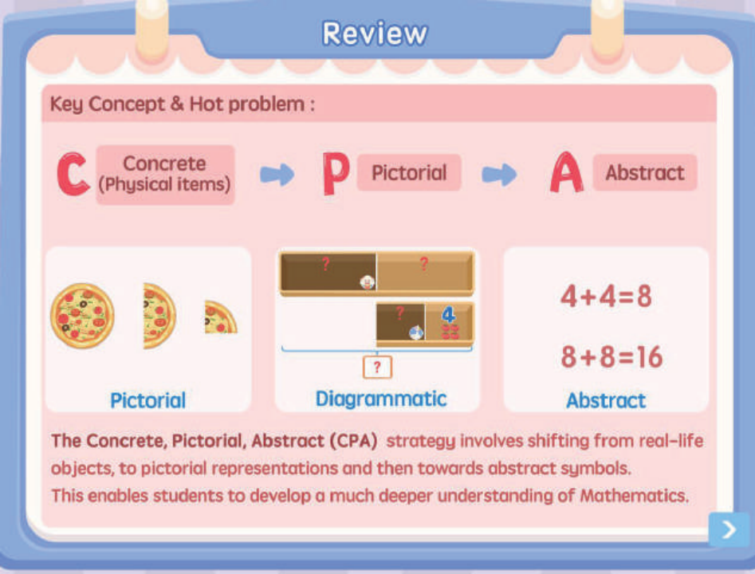
Experienced Educators & Evidence-Based Teaching Methods
- US local teachers
- Familiar with Singapore Math and US Common Core Standards, passed strict 7 rounds of pre-employment interview and intensive training process.
- Rich teaching experience, professional, familiar with children's psychology, pay more attention to children's emotions and thinking process, truly love children and understand education.
-Teachers can guide and inspire children through multiple teaching method such as effective questioning technique which give children the opportunity to think independently and explore in the classroom.

Slide 6
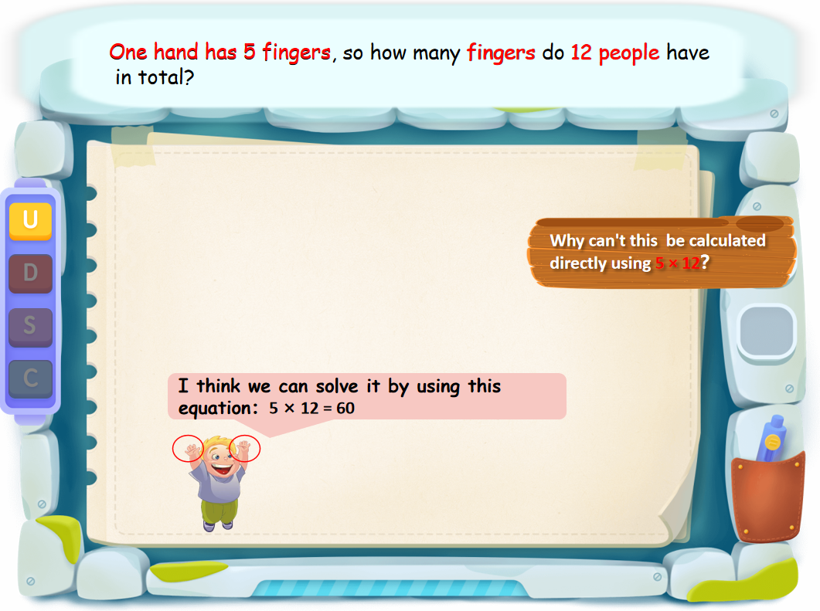

Our programs are student-centered, allowing children to ask questions and discover concepts as they engage with the teacher. The combination of heuristic teaching with a structured learning experience helps to develop self-regulation skills and good learning habits.
The UDSC Methodology
Understand the Problem: Help them identify the problem, analyze hidden information, and ensure the message is delivered
Decide on an Approach: guide children to analyze the problem, understand the core of the problem, and promote children's mastery of similar problems
Solve the Problem: focus on operations, strengthen children’s cognition of standardized problem-solving steps, and ensure that children can give the right answer to the details of the problem
Work the result back into the original question to doublecheck, and help children develop the habit of checking so as to reduce careless mistakes
Example: The teacher uses questions to stimulate children’s thinking. Where and how to start? The biggest or the smallest? Or the teacher can give the wrong answer first and let children think about why.
Notes:
会通过精巧的问题设计层层引导、多次问答，让孩子主动思考、探索，在探索思考的过程中大胆猜想，再通过课堂互动讨论和老师的启发引导进行验证，验证得到正确结论后进行反思总结，最后让孩子能够将知识举一反三、迁移应用。这种教学方式可以提升孩子的课堂参与感，让孩子在学习的过程中更专注力，思考更严谨，孩子理解新知识、新问题也会更容易，轻松突破难题。 并且，这种教学方式因为更加注重孩子的思考过程，所以更有利于培养孩子的数学思维。

Slide 7
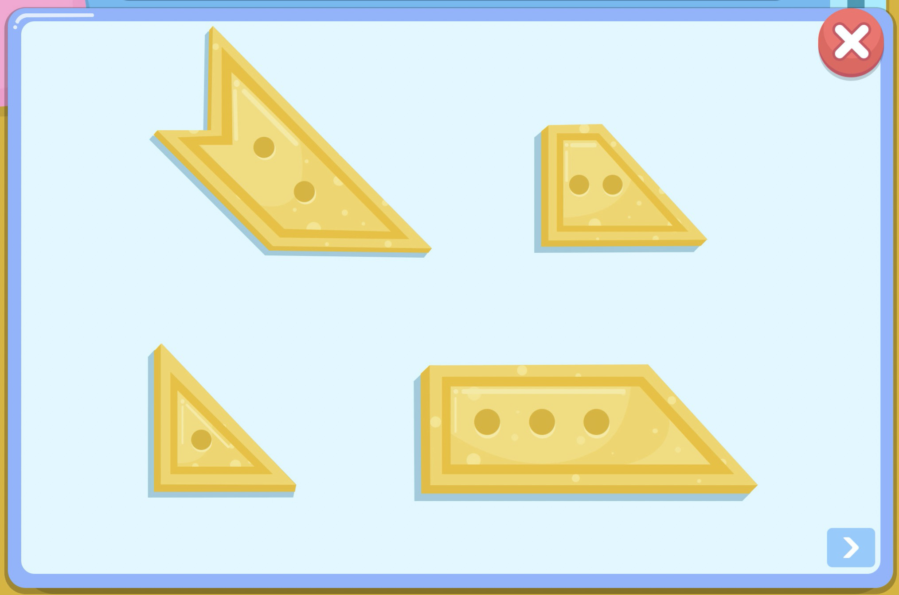
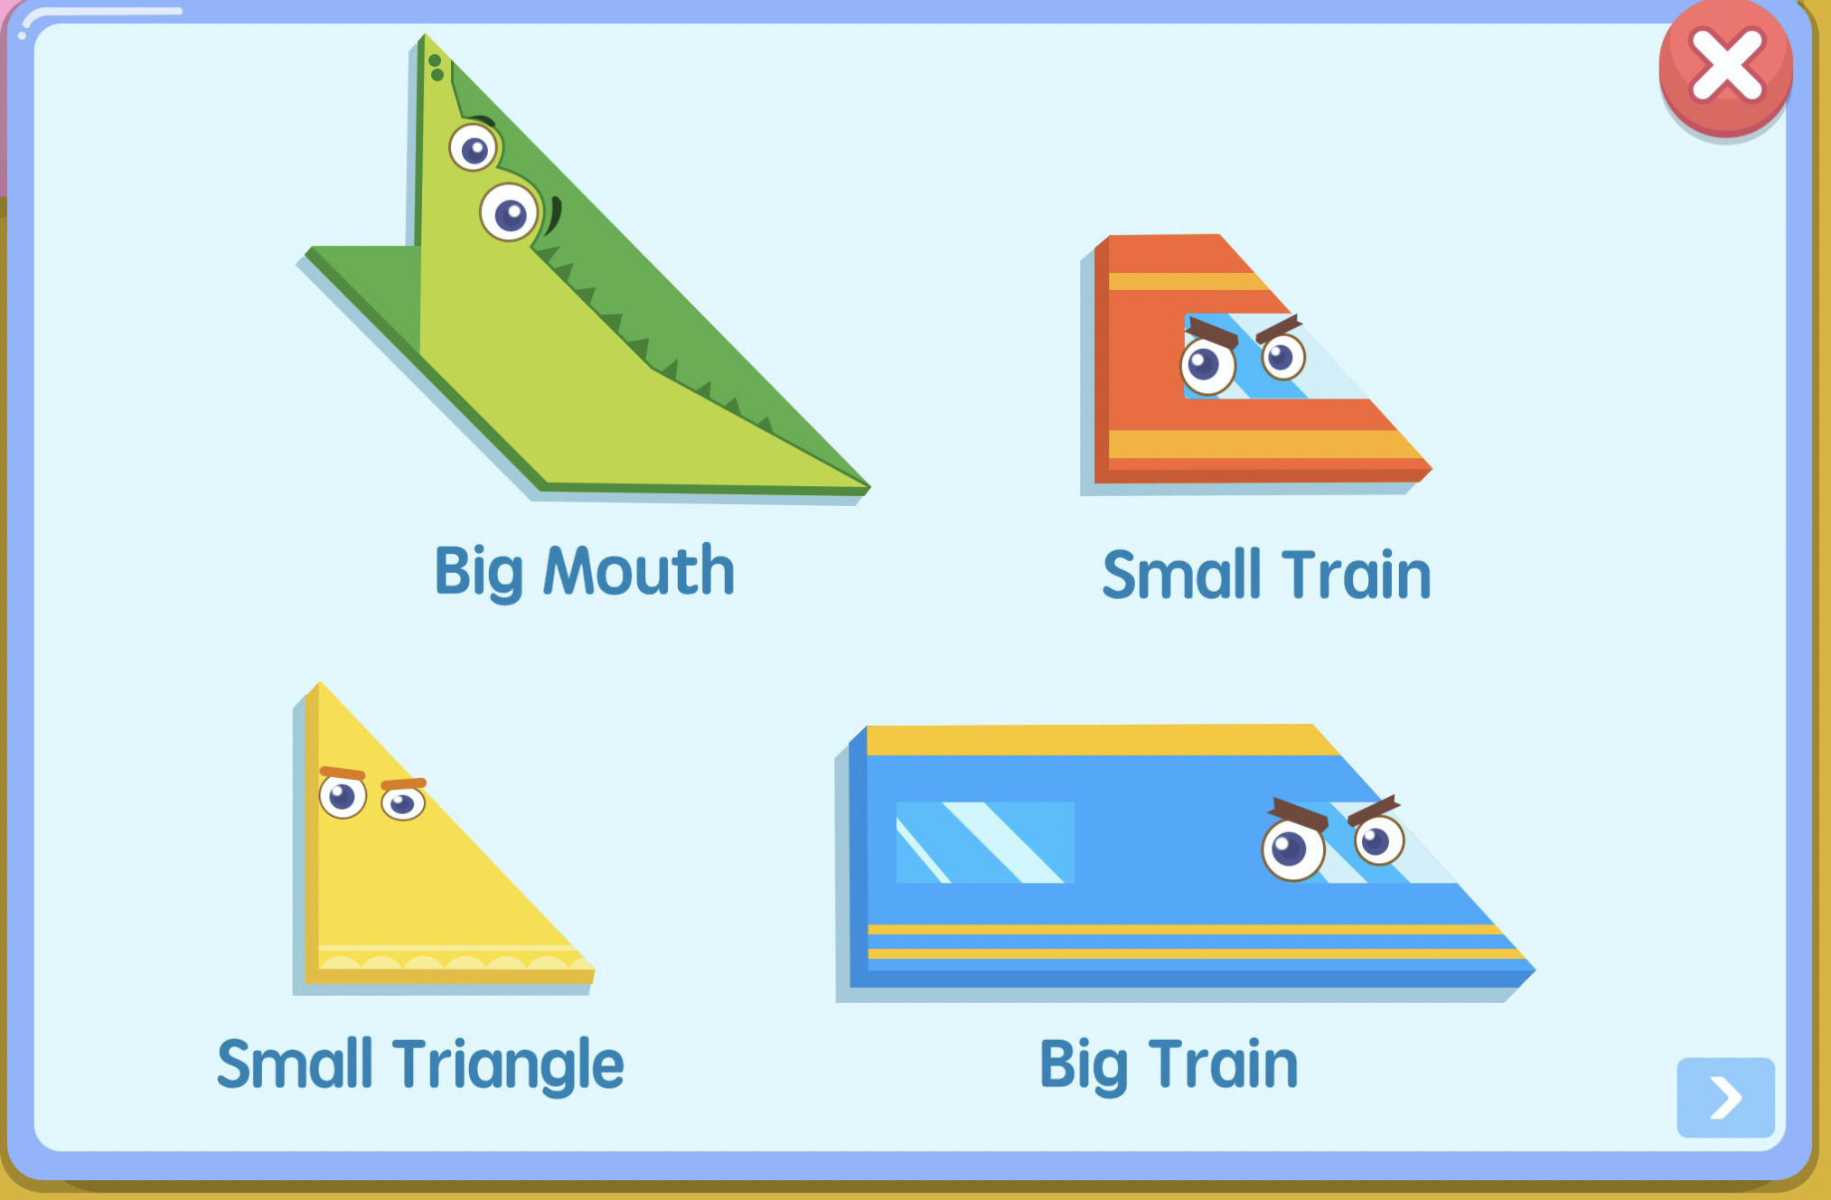

Two Interface Courseware
Engaging Interactive Courseware
  We developed 100% original content for Spark Math coursewares. Unlike traditional classrooms which depend on "textbook + blackboard + PPT", our classroom is highly operable, immersive and interactive. It integrates learning content into real-life scenarios. Children's hands-on operation is accompanied by teachers’ guided questions. In this learning environment, children's thinking can be fully mobilized, so as to achieve better learning outcomes
    -Animated stories to attract children's attention -Present concrete scenarios for abstract problems, games for uninteresting problems -Hands-on experience to enhance students’ imagination and absorb knowledge -Hidden levels for personalized practice -Targeted guidance in time for students who can't finish the exercise -Every child has a chance to speak
    -Opportunity to speak in front of the class

Slide 8
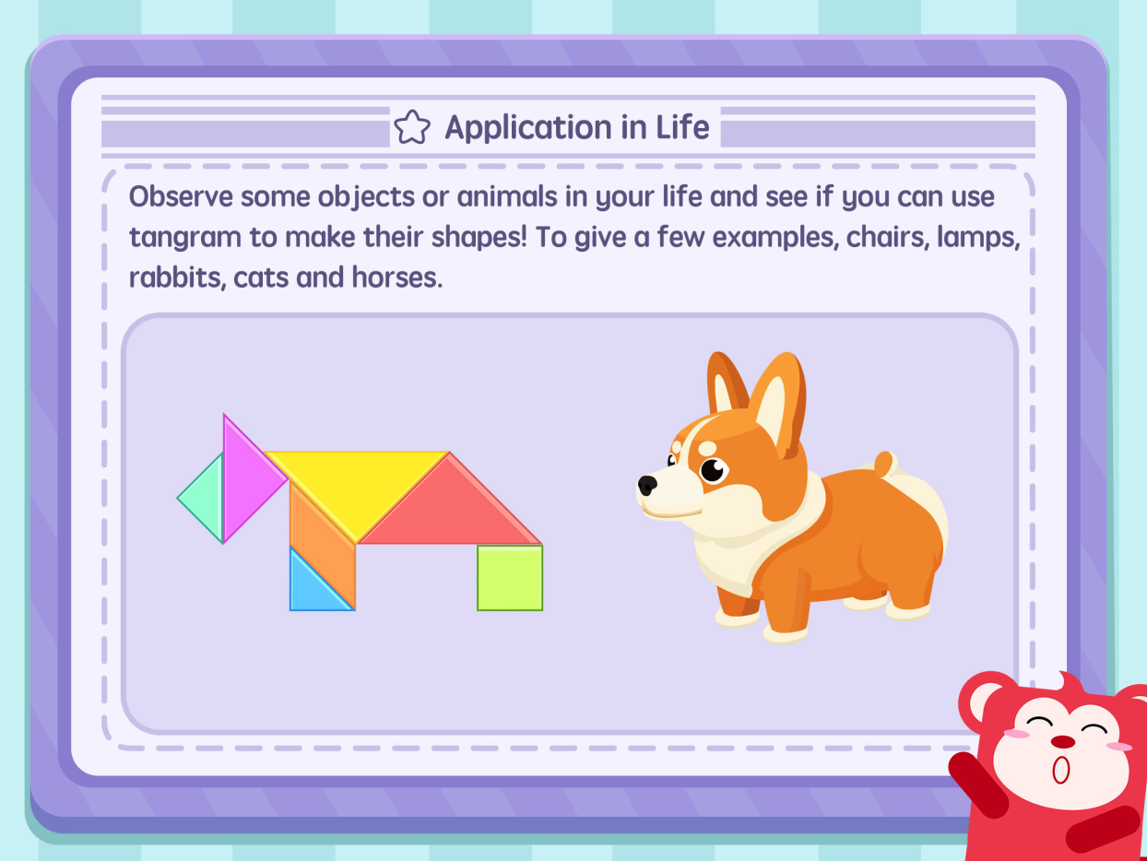
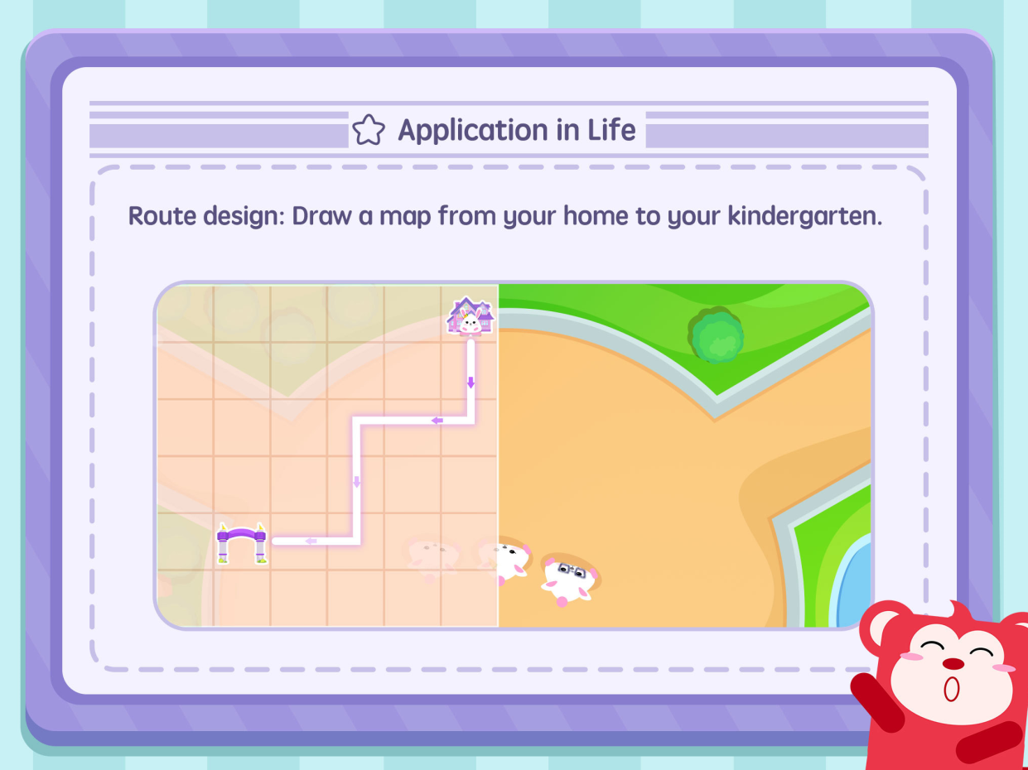
Two way interfaces – Teacher and AI Interaction
with gamify questions and animations

Slide 9
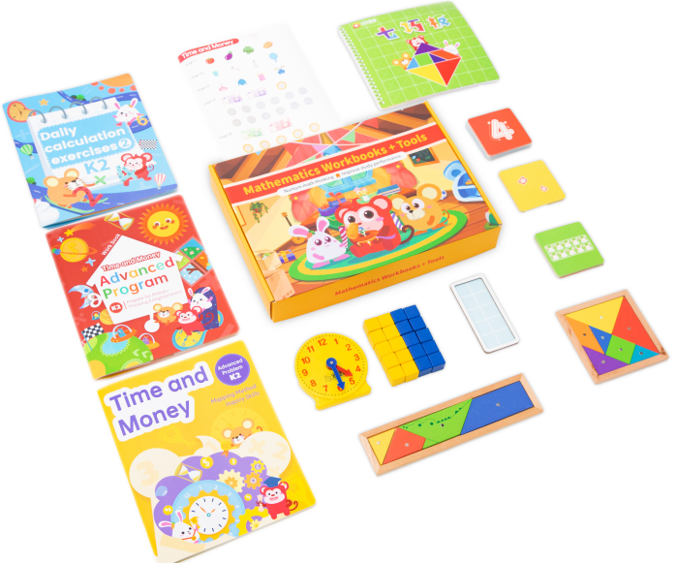

Two way interfaces – Teacher and AI Interaction
with gamify questions and animations
Animated presentation to build better foundation
Provide learning kits for each lesson
to improve hands-on ability

Slide 10
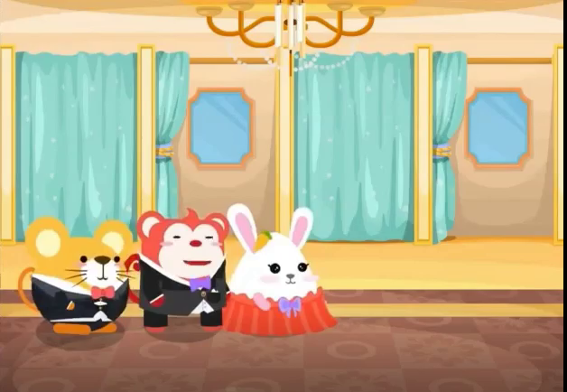

Two way interfaces – Teacher and AI Interaction
with gamify questions and animations
Animation and a full set of stories

Slide 11
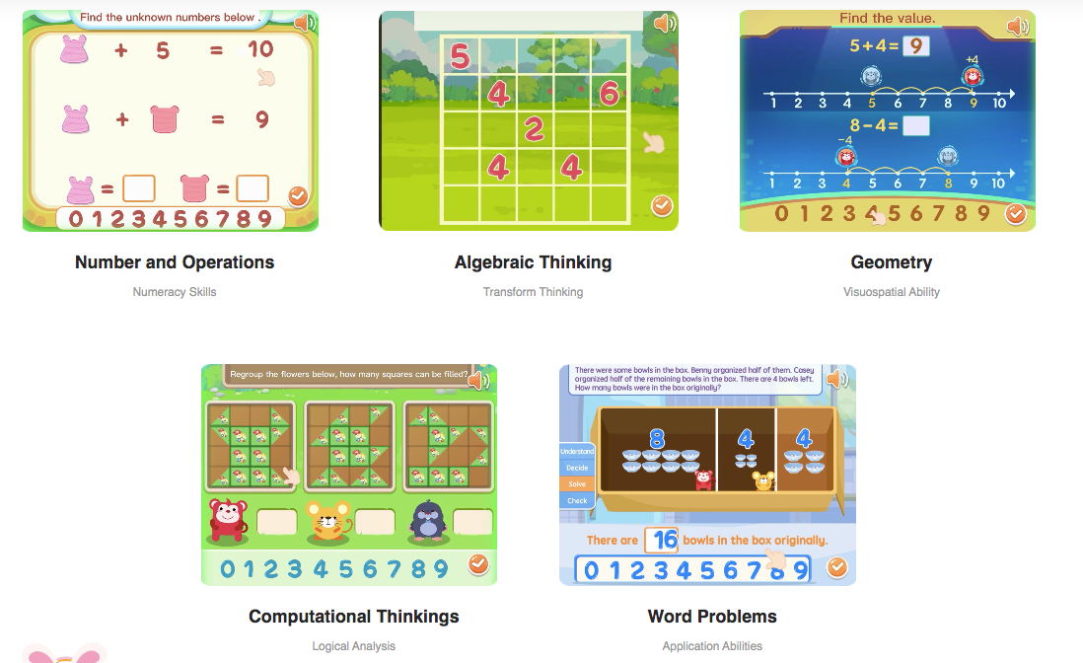
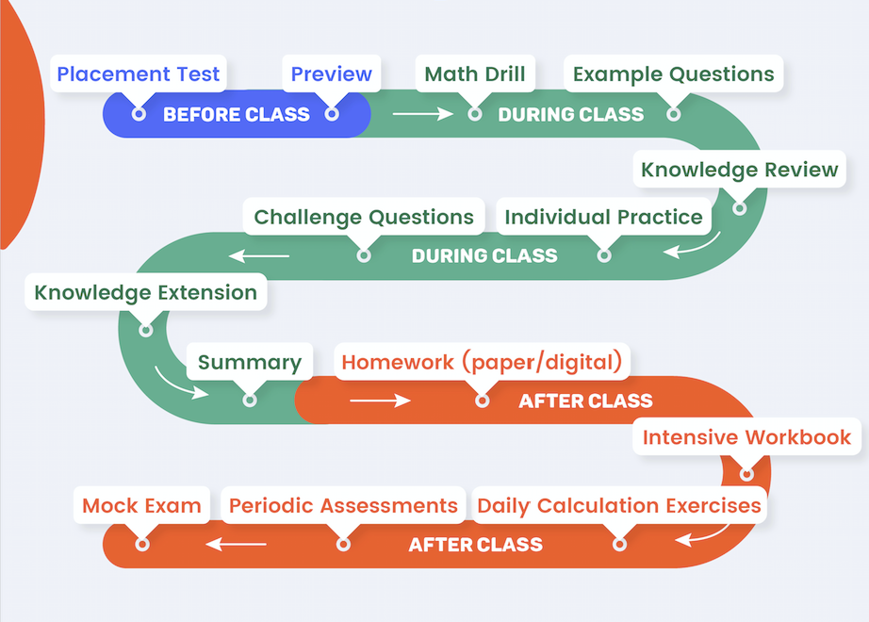
Comprehensive Course Modules & Complete Sequence of Study
- Rather than lessons on individual topics, we offer complete units of study. Each course is aligned vertically with one another, to create a seamless transition from one program to the next.
- Each course has 5 thematic modules:

Slide 12
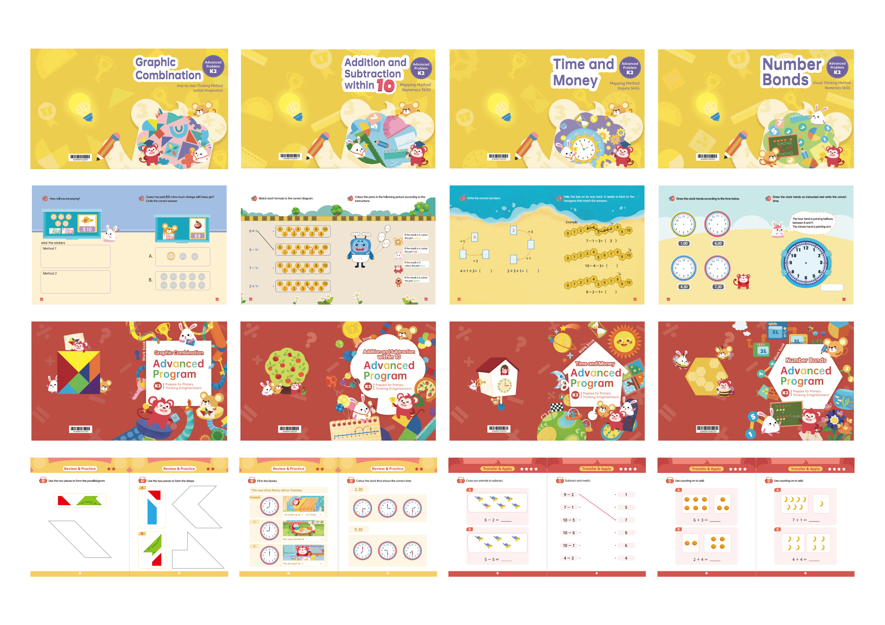
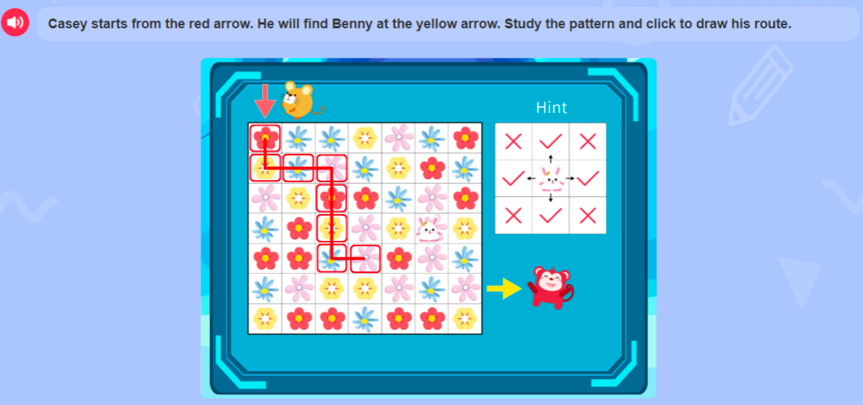
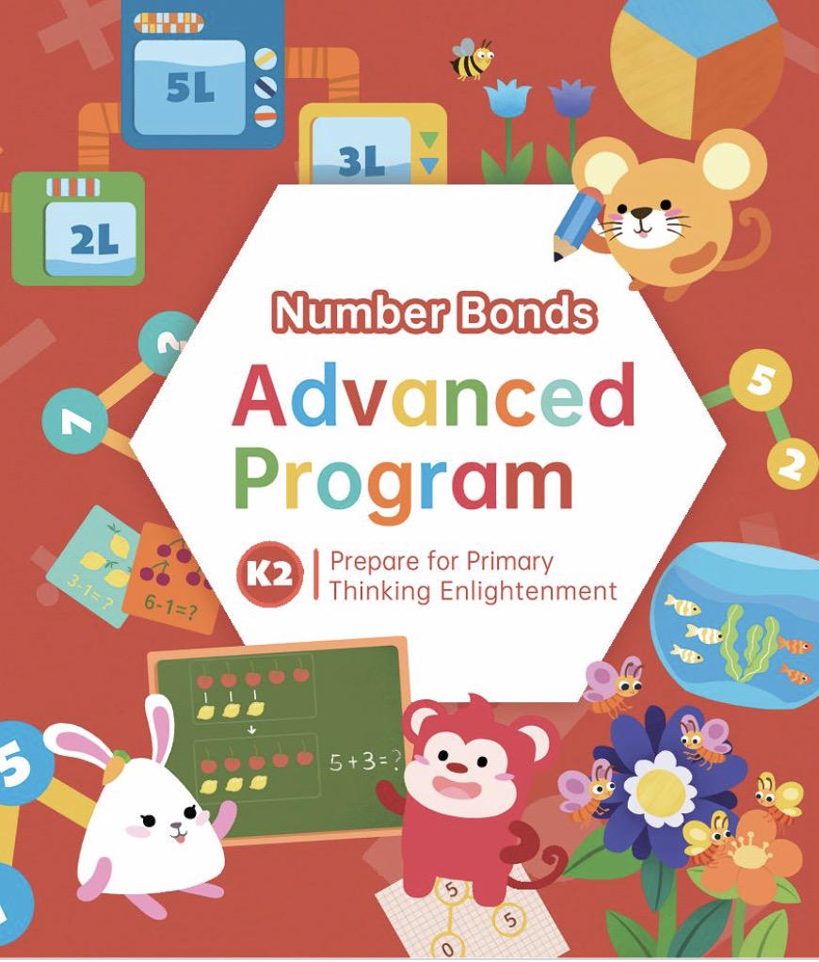
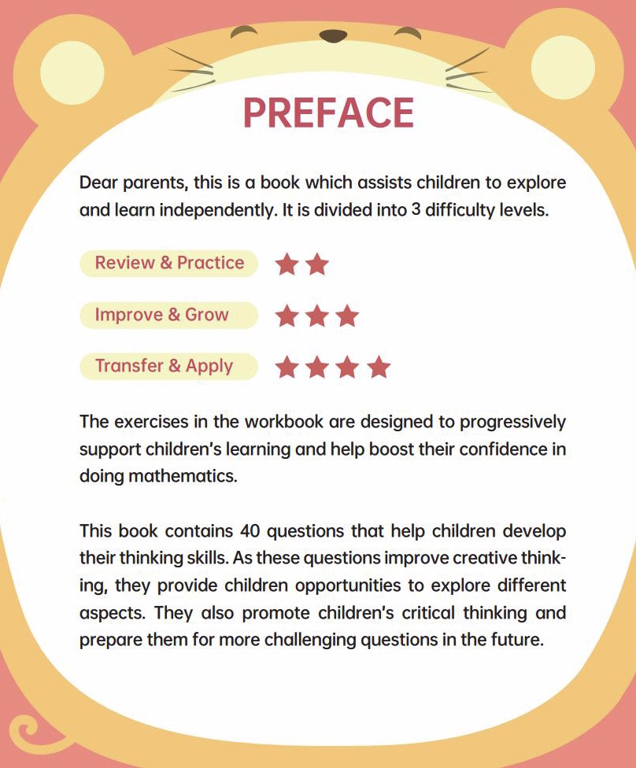
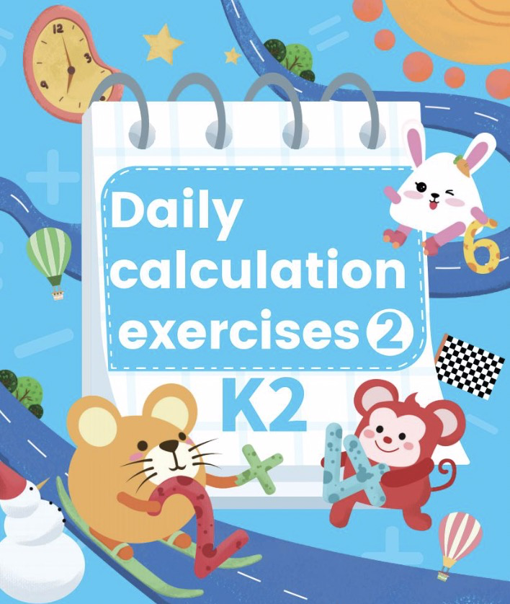
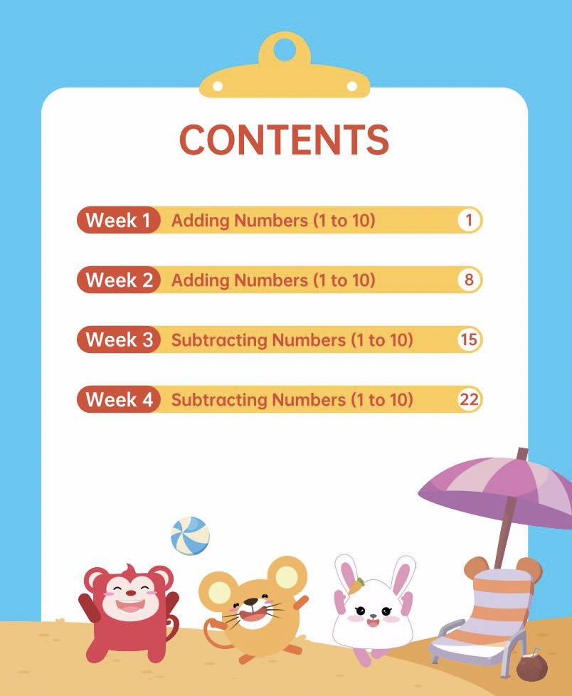
While recurring classes allow children to learn and interact with their teacher and peers, our program also considers the importance of independent learning and practice. Families receive supplementary learning materials, or a learning kit, that includes workbooks and manipultatives that coincide with course topics.

Slide 13


Course Planning & Learning Services
Education Consultant: We know the parents needs and make sure students are at the right programs
Teachers: Pay attention to students learning in class, and keep track of the learning progress
Customer Success: Parents can see the progress on the app, and we have customer success to fully support during the program
Education
Consultant
Teachers
Customer Success

